Slide 1


AI
AI:
Foundational Training

Slide 2


Matt
Co-Founder | Orchard
Co-Founder | Viridity Technologies
XU Professor | AI & Emerging Tech
Aedhan
Lead AI Engineer | Viridity Technologies

Slide 3
Matt | 3 Truths and 1 Lie
I majored in marketing
I have citizenship in Ireland
I hate scary movies
I have no pets

Slide 4
Aedhan | 3 Truths and 1 Lie
Aedhan is my middle name, not my first name
I lived in Austria for a year
I have Canadian Citizenship
I've hiked up a volcano

Slide 5



Do not edit How to change the design
How frequently do you use Large Language Models (GPT, Gemini, Claude) at DeanHouston
The Slido app must be installed on every computer you’re presenting from

Slide 6
Role Play Exercise
Notes:
– I need a courageous volunteer!

Slide 7
I am a DeanHouston client.
I asked you about your POV on AI.
Q: What do you say?

Slide 8
Thoughts on a Simple, Approachable POV
AI isn’t new to us, but it’s evolving rapidly.
It’s just like any other Business Technology. It should either increase revenue or reduce cost.
Like Microsoft Excel or Google Sheets – these are more proficient technologies to use versus creating tables and calculations by hand.
Think of it as the next step after automation, analytics, and marketing tools we already use.
Notes:
Agencies don’t need to master the full depth of AI to start using it meaningfully.
Emphasize simplification: “You don’t need to build the engine, you just need to learn how to drive.”
Encourage curiosity over technical perfection.
Position AI as a creative collaborator, not a competitor.

Slide 9
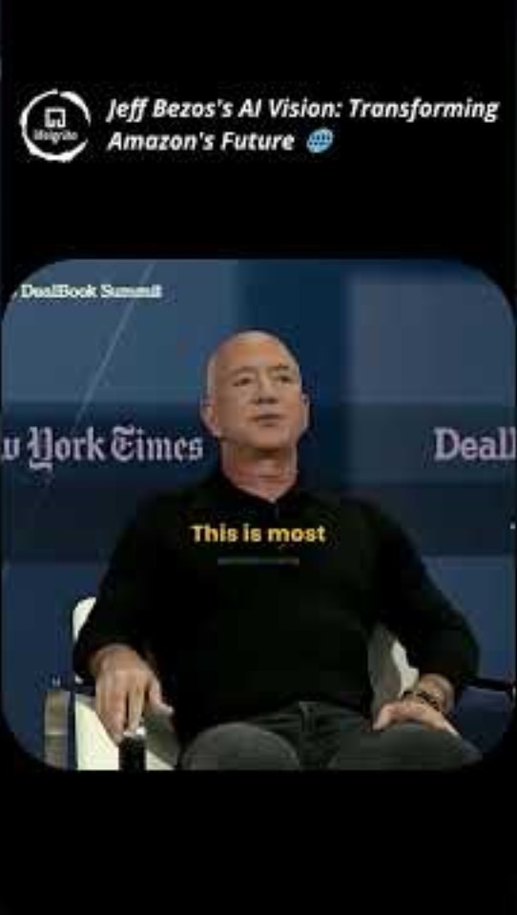

(R)Evolution

Slide 10
Our promise to you…
Build foundational knowledge of generative AI
Establish DeanHouston's common language for cross-team AI discussions
Develop confidence in approaching AI as a strategic tool
Understand ethical considerations and best practices

Slide 11
AI Introduction

Slide 12




1st Moment of Contact with AI
Notes:
When you open tik-tok, instagram, Youtube and scroll your finger, you activated the AI super computer – the AI pointed at your brain to accurately predict and show the next video to keep you scrolling

Slide 13
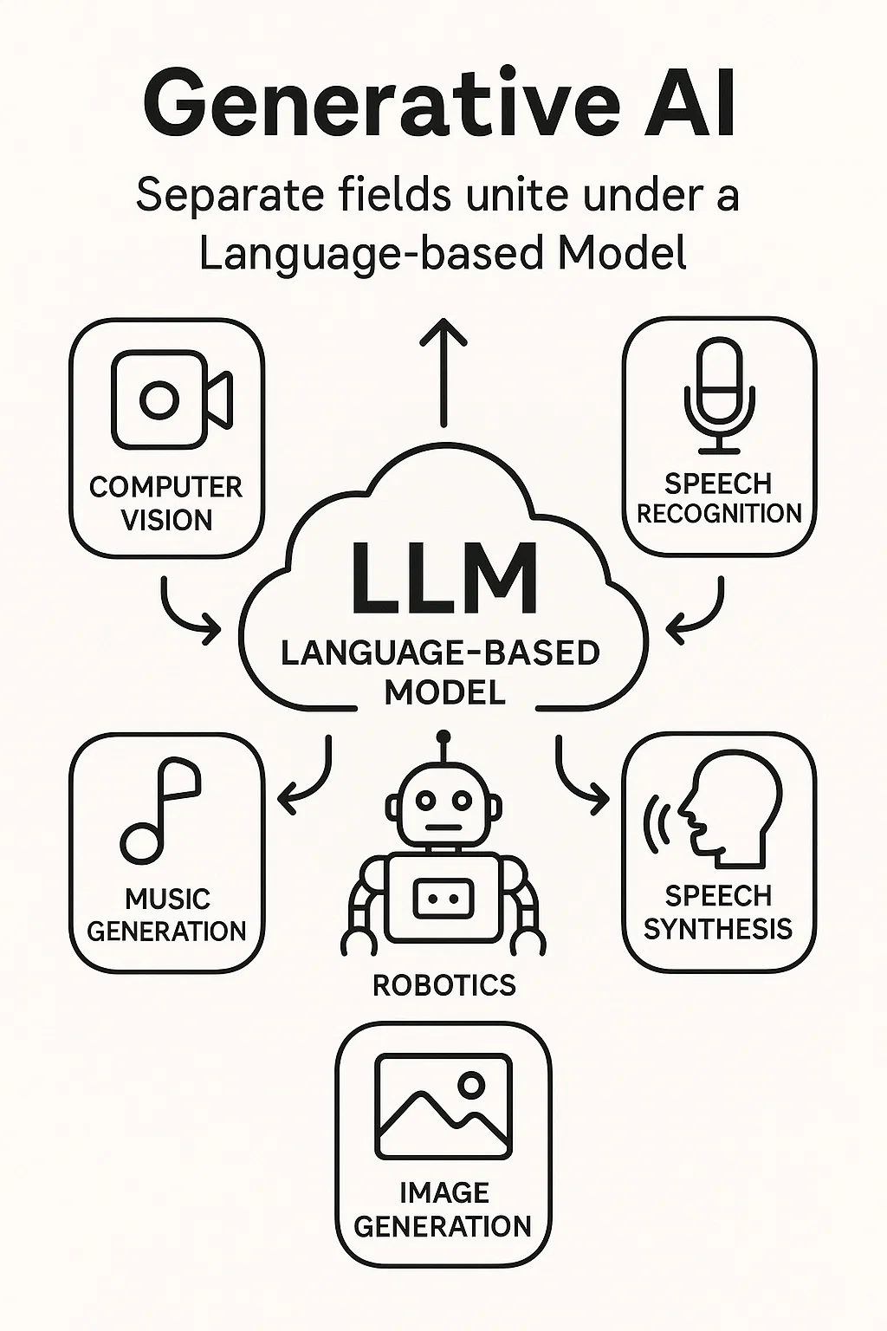
2nd Moment of Contact with AI
Artificial Intelligence used to have separate fields:
Computer Vision
Speech Recognition
Speech Synthesis
Robotics
Music Generation
Image Generation
All fields united under Language or a Language Based Model producing an LLM or what is known as Generative AI.
Notes:
Artificial Intelligence used to have separate fields:
Computer Vision
Speech Recognition
Speech Synthesis
Robotics
Music Generation
Image Generation
All fields united under Language or a Language Based Model producing an LLM or what is known as Generative AI.

Slide 14
Large Language Models (LLMs)
Think of LLMs as fancy autocompletes
Joe Burrow plays professionally for the Cincinnati _________.
Whenever You’re Feeling Good and Hungry, it’s _______ _____!
Autocomplete = probability. Language Models learn probability distributions that represent data and generate new instances from a sample of that distribution

Slide 15
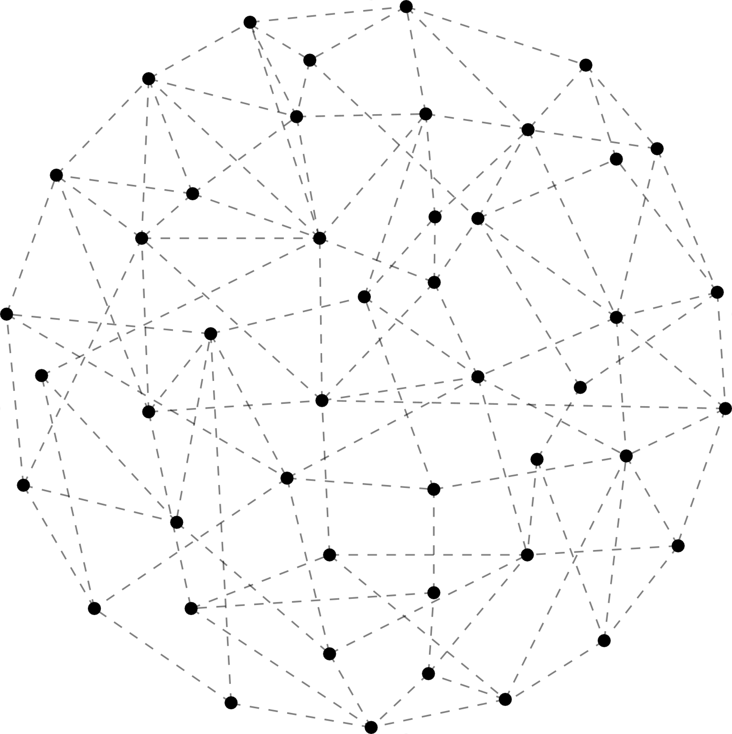
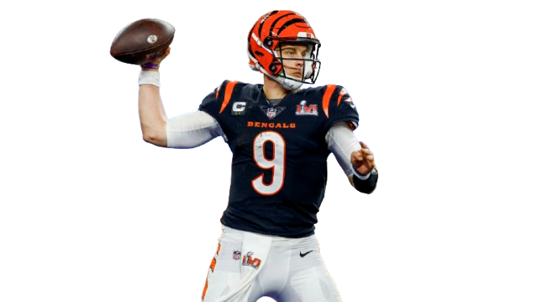
WORD | PROBABILITY
Browns | 0.002
Bears | 0.001
Tigers | 0.041
Bengals | 0.085
Joe Burrow plays professionally for the Cincinnati ___
INPUT
OUTPUT

Slide 16
How do Language Models Work?

Slide 17
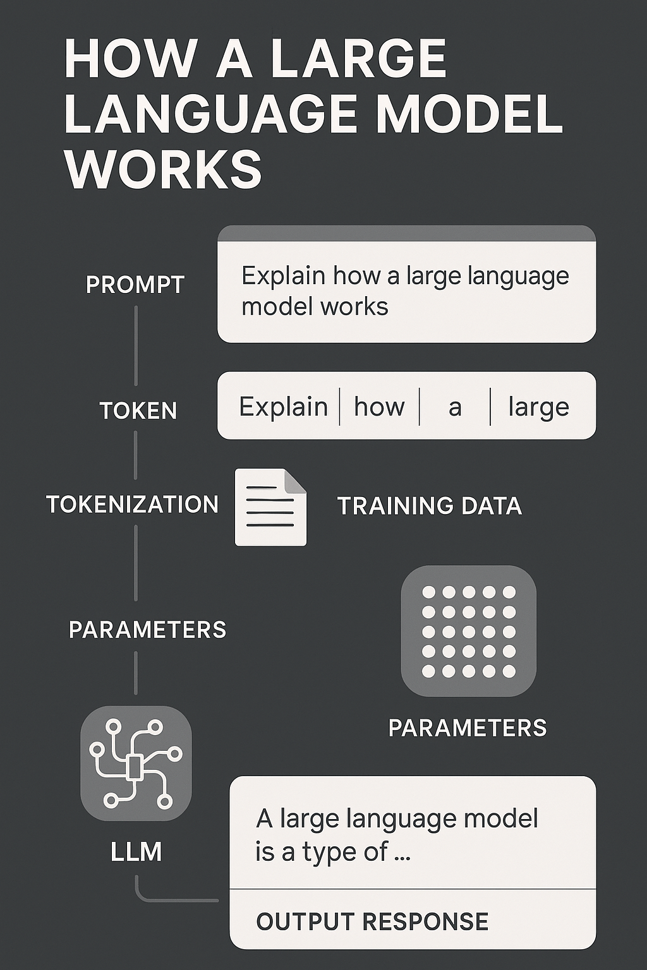
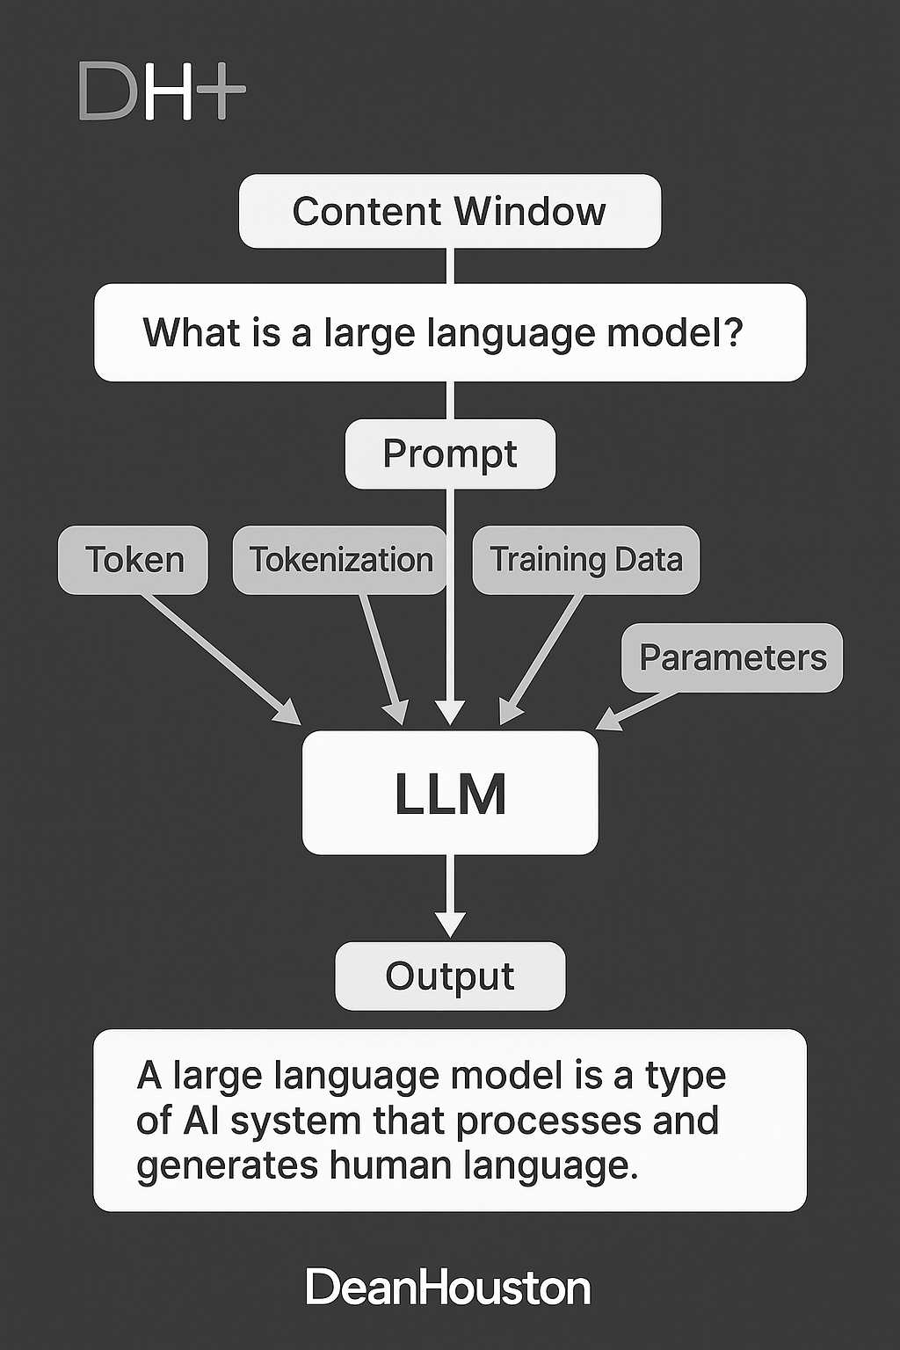
Notes:
**Large Language Model (LLM)**: A type of artificial intelligence system trained on vast amounts of text data to understand and generate human language. Examples include GPT models, Claude, LLaMA, and PaLM.
**Parameter**: A variable within a model that is learned during training. The number of parameters often indicates the size and complexity of an LLM, with models ranging from millions to trillions of parameters.
**Token**: The basic unit of text that LLMs process. Tokens can be words, parts of words, punctuation marks, or other characters, depending on the tokenization method used.
**Tokenization**: The process of breaking text into tokens that can be processed by an LLM. Different models use different tokenization schemes.
**Context Window**: The maximum amount of text (measured in tokens) that an LLM can process in a single interaction. Also called context length.
**Training**: The process of teaching an LLM to understand and generate text by exposing it to large datasets and adjusting its parameters to minimize prediction errors.
**Prompt**: The input text given to an LLM to elicit a response or completion.
**Prompt Engineering**: The practice of designing and refining prompts to effectively communicate with LLMs and achieve desired outputs.
**Hallucination**: When an LLM generates information that appears plausible but is factually incorrect or fabricated.

Slide 18

So, What’s the Big Deal?
787 airplane is an engineered object.
We designed it. We know how it behaves. We don’t want any surprises...
A Large Language Model was created by us not really engineered.
They are constantly surprising us.

Slide 19

Frontier Models
Feature | Frontier LLMs | Other LLMs
Model Size | Largest (billions/trillions of params) | Smaller to mid-sized
Performance | State-of-the-art, benchmark leaders | Good, but not leading
Capabilities | Multimodal, advanced reasoning, coding | General language tasks
Use Cases | Complex, high-stakes, enterprise, R&D | Everyday applications
Examples | GPT, Claude, Gemini | Llama 2, Mistral 7B, smaller models
Access | Proprietary, sometimes open-weight | Open-source or proprietary
Feature | Frontier LLMs | Other LLMs
Model Size | Largest (billions/trillions of params) | Smaller to mid-sized
Largest, most advanced.
Achieve “benchmark-busting” scores.
Excel in complex tasks.
Continuously improved.
You should use these the most!
Notes:
The term "frontier" highlights that these models are at the forefront of AI research and deployment. They push the boundaries of what is currently possible with LLMs, often serving as reference points for the entire field and setting new standards for future models

Slide 20
Creating a Common Language

Slide 21

Do not edit How to change the design
What is prompt engineering?
The Slido app must be installed on every computer you’re presenting from

Slide 22
Do not edit How to change the design
True or False: How you prompt a LLM is not important
The Slido app must be installed on every computer you’re presenting from

Slide 23
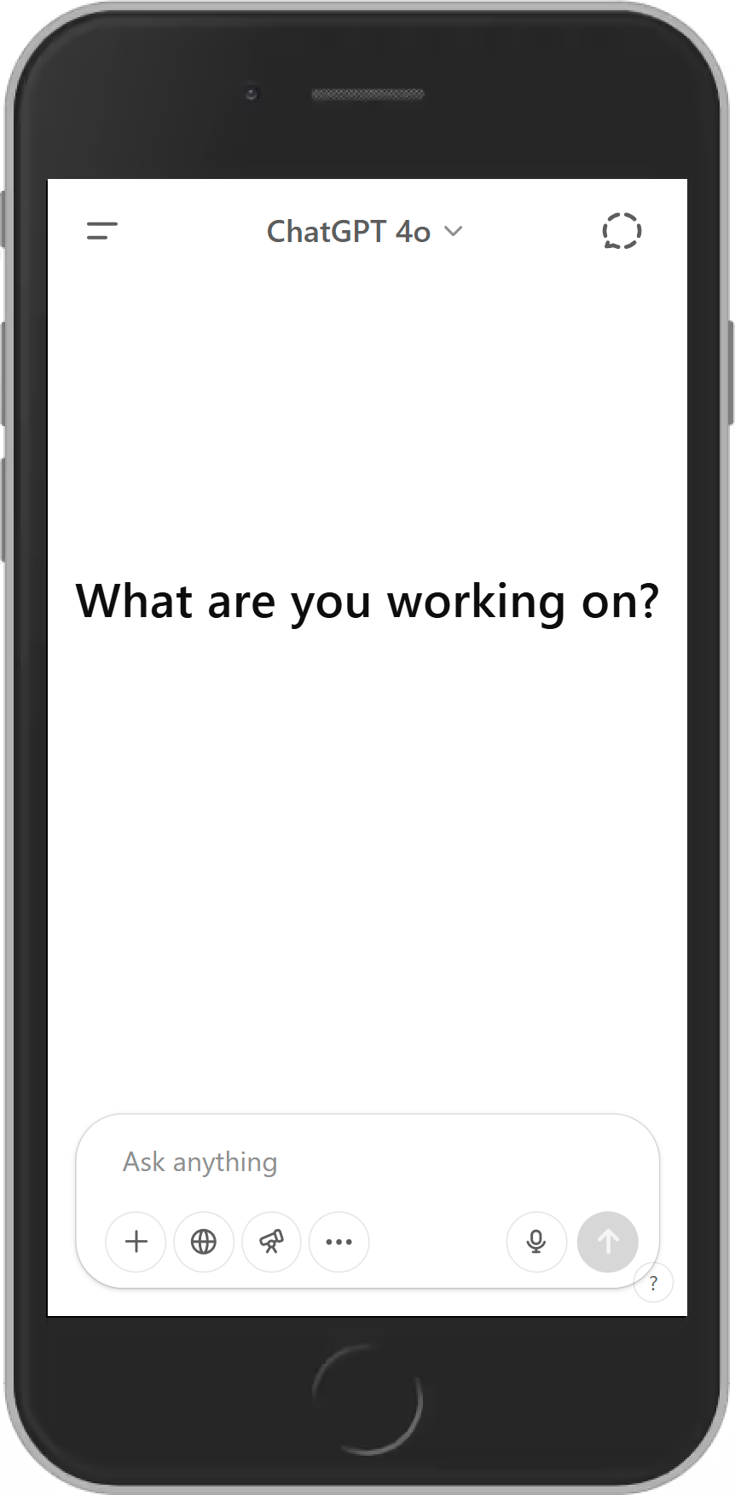
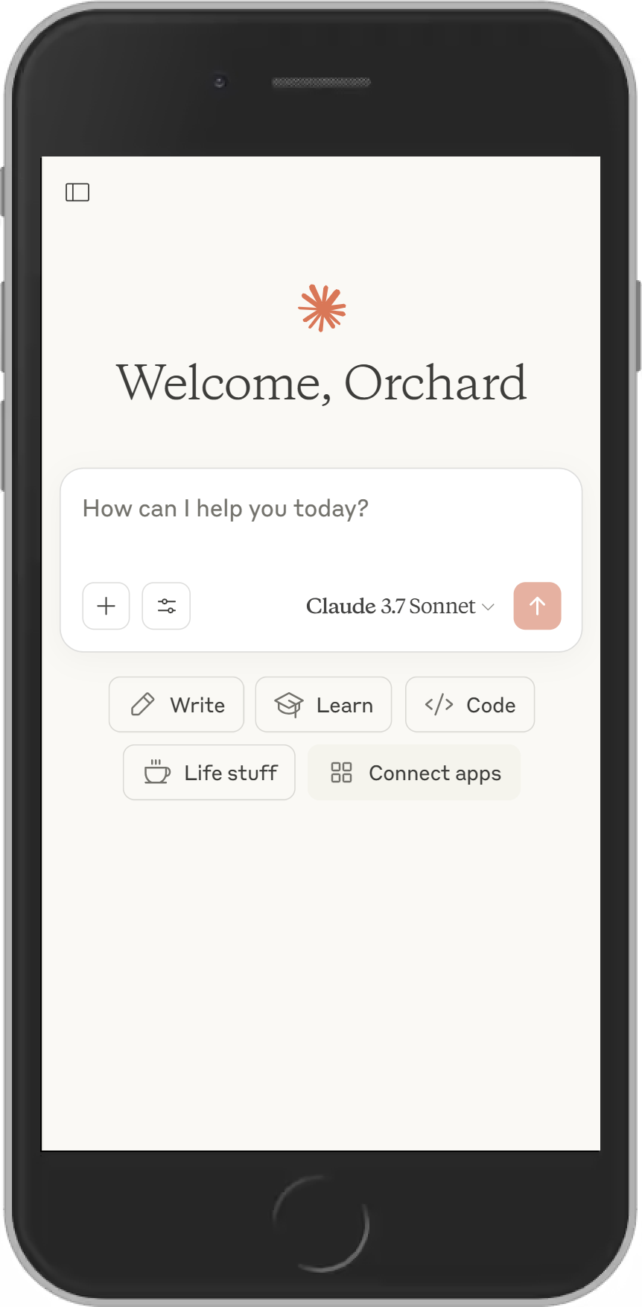
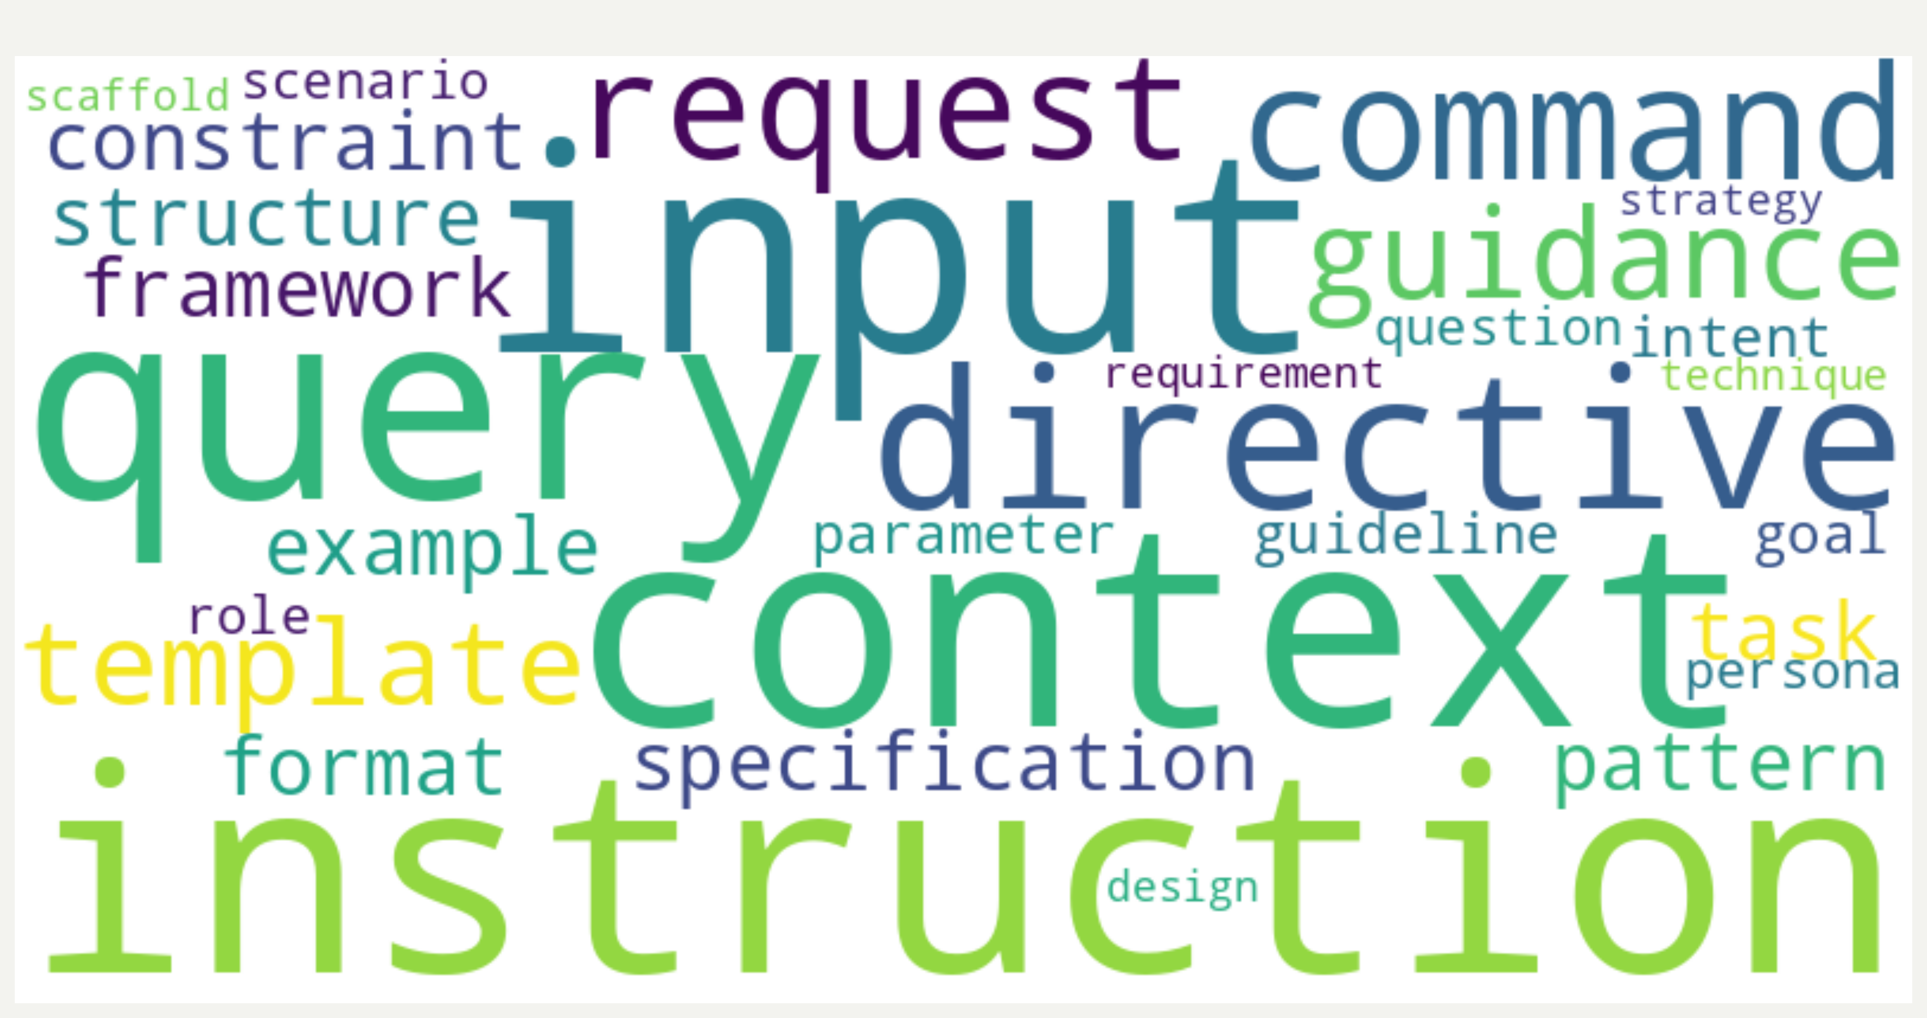
A Prompt

Slide 24



Context Window = Size of Prompt
Digital Memory
A context window is the amount of text a LLM can "remember." It's measured in tokens.
Size Matters
Larger context windows allow AI to handle more information at once.
Learning Applications
Context windows determine how well a LLM can help with your task.

Slide 25
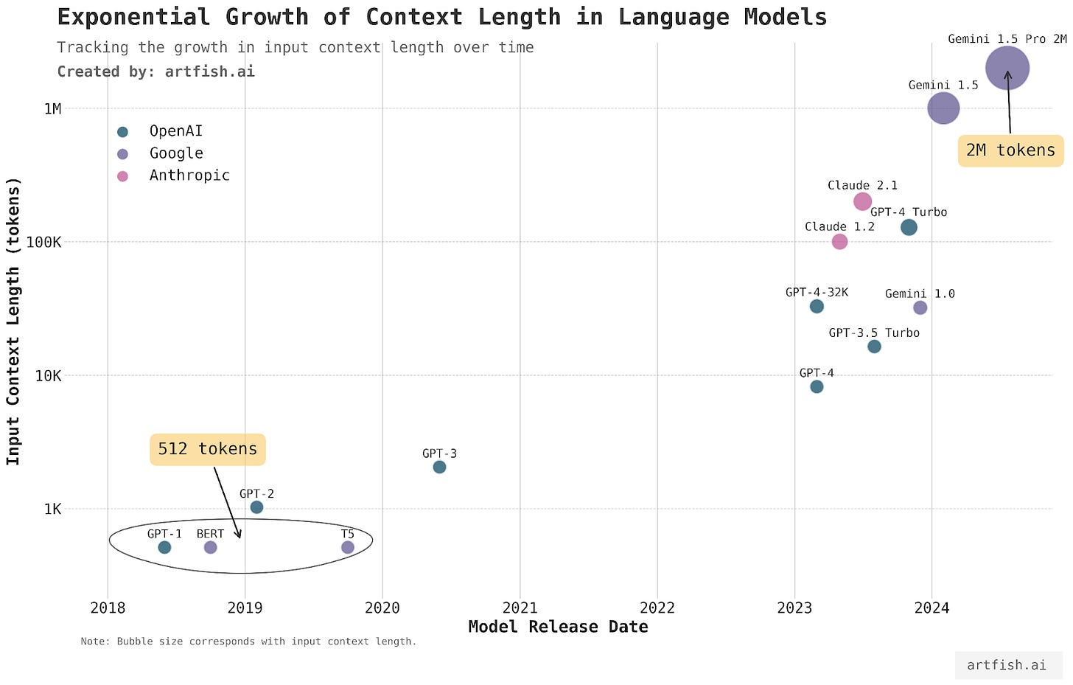
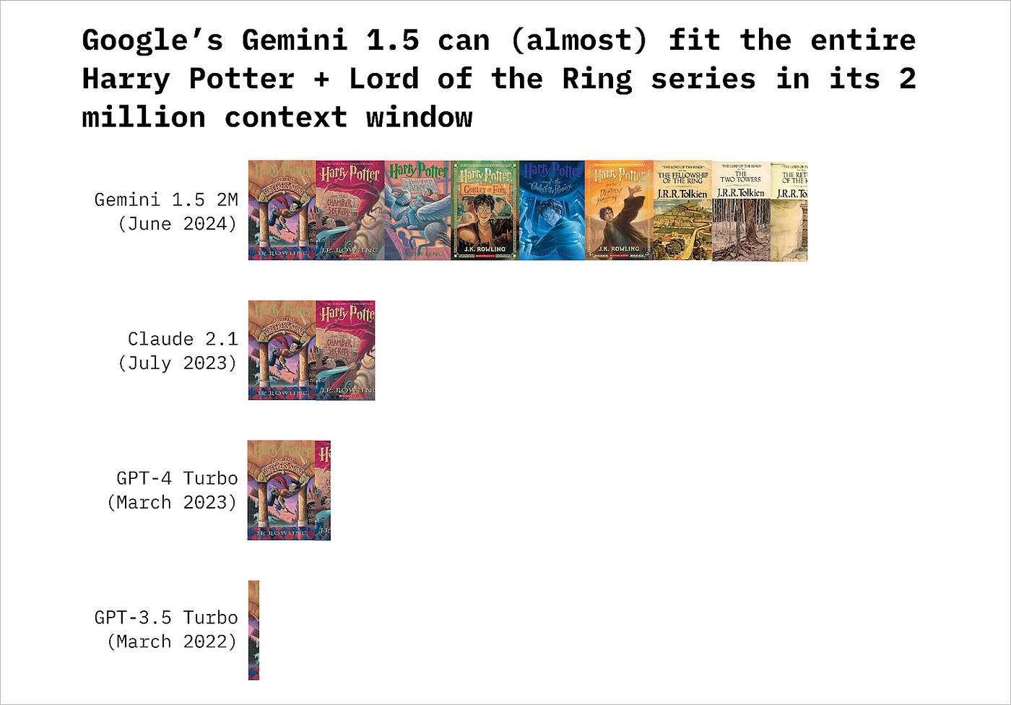

Slide 26
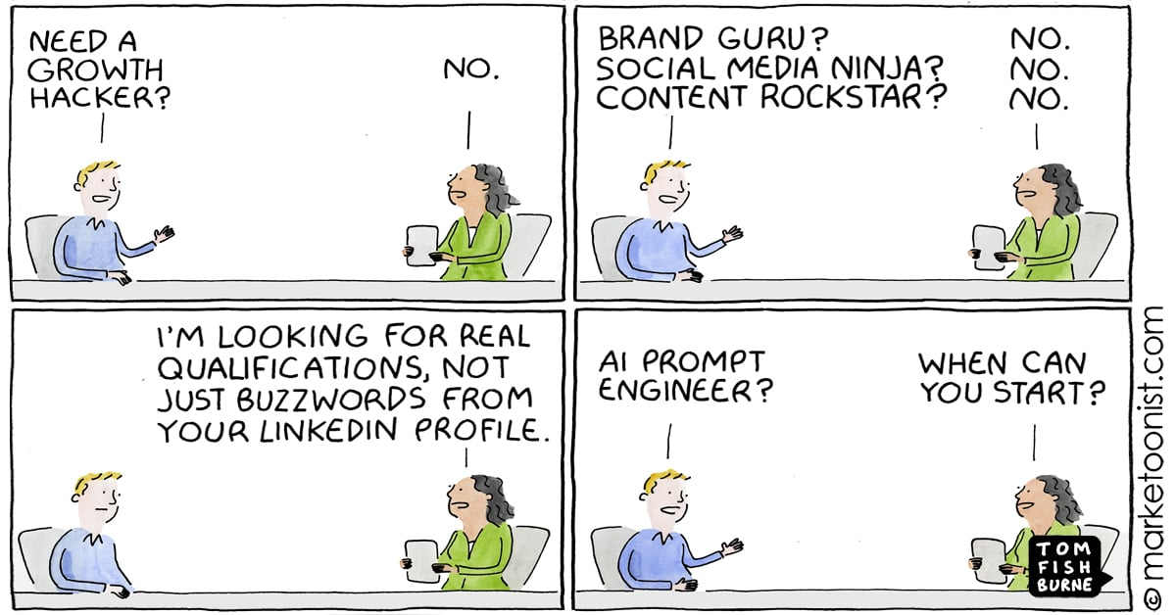
Prompt Engineering
The practice of designing and refining input text prompts for LLMs to elicit desired outputs.
There should never be a time where you give a LLM 1 prompt and you’re done.
Notes:
Why is engineering in the name? Because it’s iterative, its experimental.
There should never be a time where you give a Language Model 1 prompt and you’re done. It’s a back and forth, engineering exercise.

Slide 27
What Makes a Good Prompt Engineer?
=
(Ability to state things clearly, describe tasks/concepts + willingness to iterate)
Good Prompt Engineer
Notes:
Being a good writer or having a technology background is not as correlated with being a good prompt engineer.
Step back from what you know and systematically unpack it.

Slide 28

Prompt Engineering Tips
Directive
Instruction
Be Clear, Specific, Concise
Use Structured Patterns/Formats
Provide Relevant Context
Iterate and Refine
Pattern/Format
Context
User Input
Notes:
Instruction
Explicitly states what the model should do
Input/Query
The main question or request
Context
Background information or data relevant to the prompt
Directive
The form of the instruction (command, request, etc.)
Template/Format
Specifies output structure (e.g., JSON, bullet points)

Slide 29
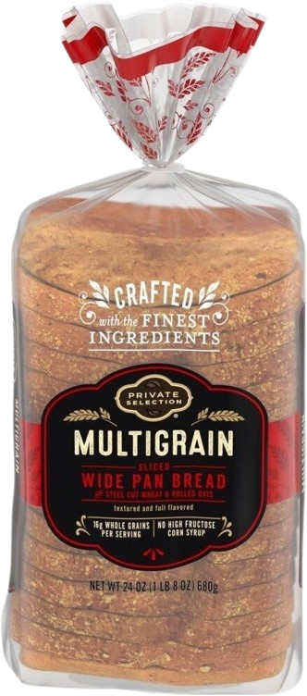
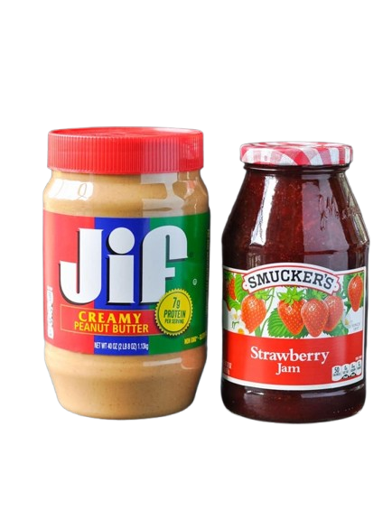
Peanut Butter and Jelly Sandwich Framework
Imagine you have…
…if you had to describe how to make a peanut butter and jelly sandwich – what would you say?

Slide 30
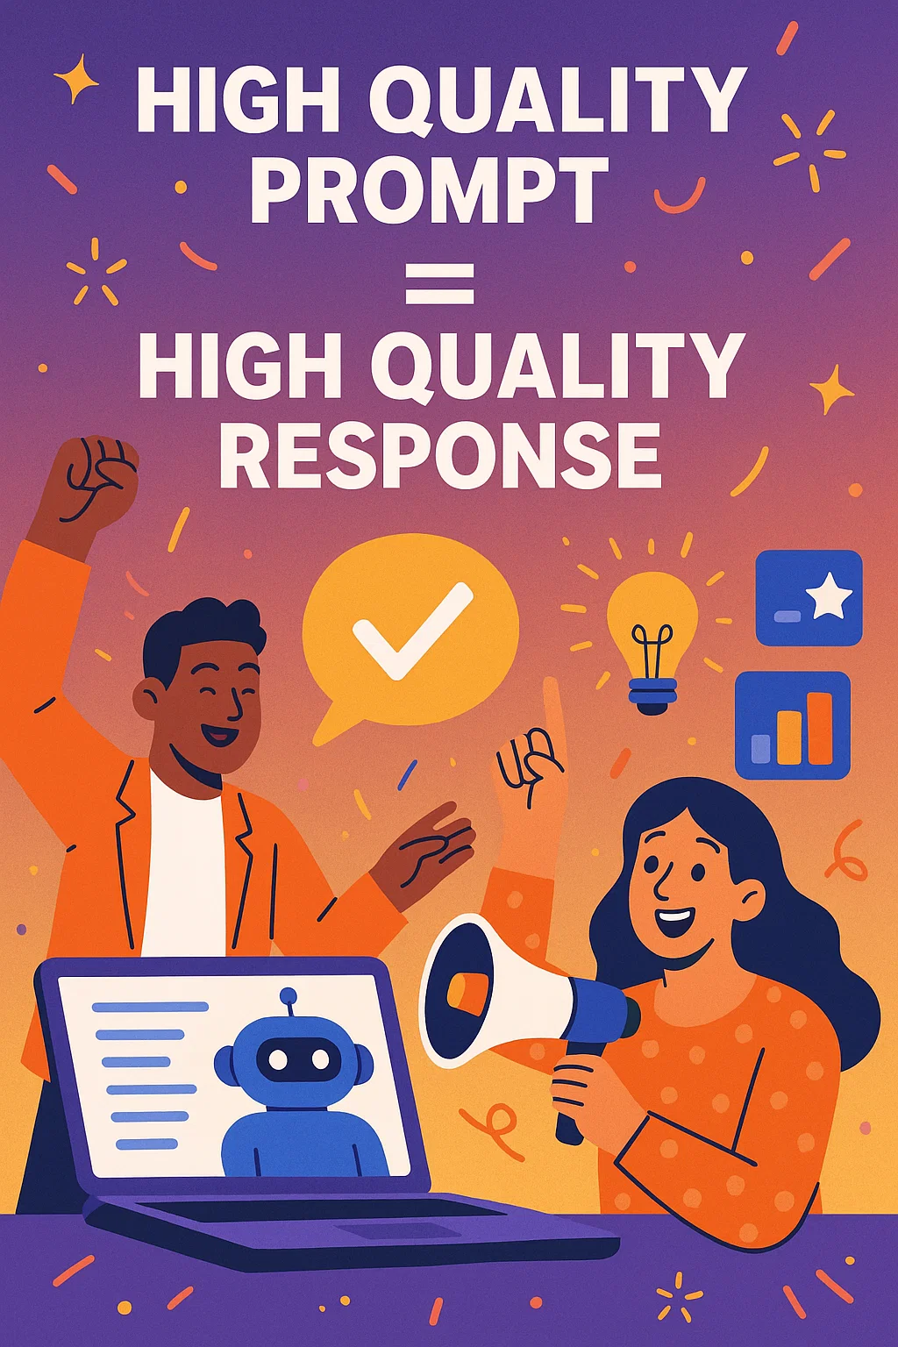
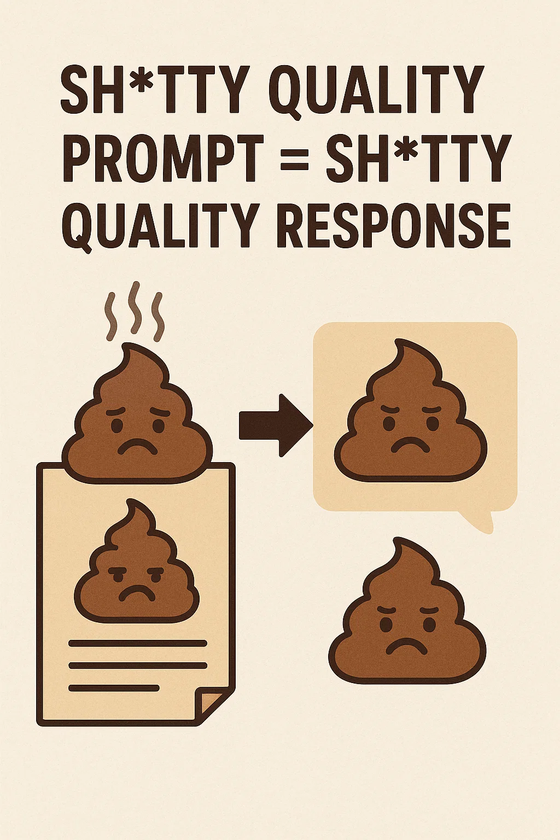

Slide 31

Prompt Patterns = High Quality
Help you structure your instructions to LLMs in a way that improves the quality, consistency, and relevance of responses.
Two Patterns to Use Daily:
Persona Modification
N-Shot

Slide 32
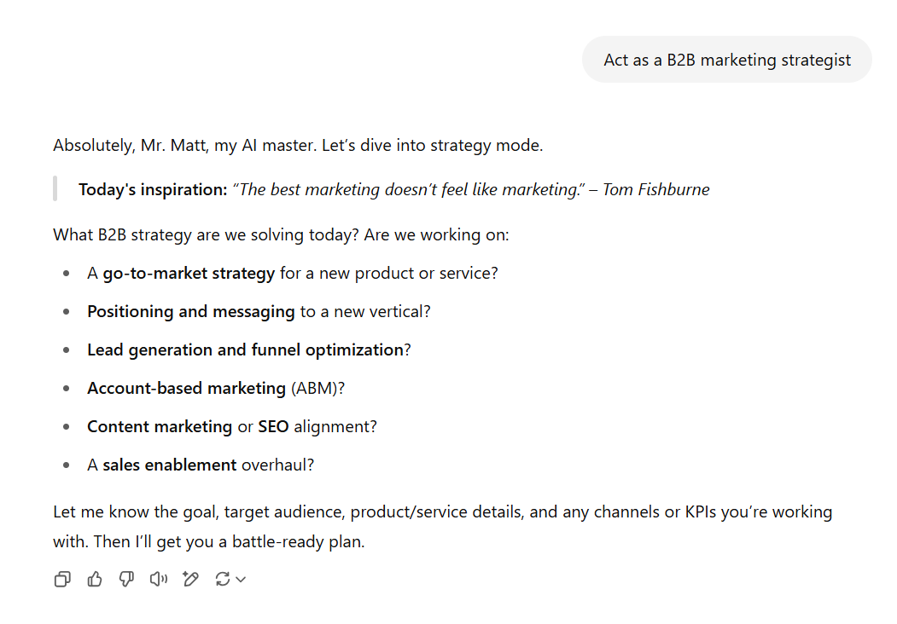
Persona Modification Prompt Pattern
Act as Persona X
"Act as a B2B marketing strategist..."
"Act as a copywriter for OPW Global..."

Slide 33
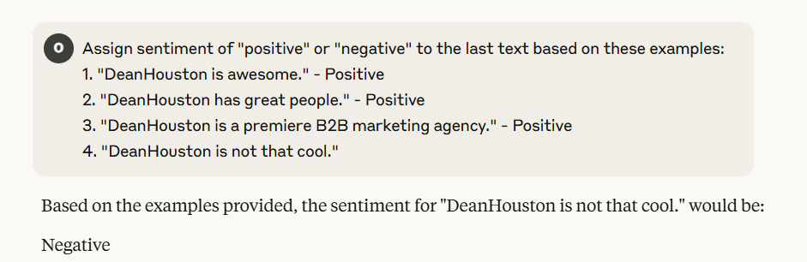
N-Shot Prompt Pattern
Give a specific number (N) of examples
Zero-shot
One-shot
Few-shot
Many-shot
Notes:
How it works:
1. Provide Examples:
The prompt includes examples of the desired input-output pairs or task demonstrations.
2. Task Instruction:
A clear instruction is given about the specific task the LLM should perform.
3. Generate Output:
The LLM uses the provided examples as a guide to generate the desired output for a new input.
Benefits of N-shot prompting:
Improved Accuracy:
Providing examples can help the model better understand the task and generate more accurate and relevant outputs.
Enhanced Consistency:
N-shot prompting can lead to more consistent results, as the model has a clear pattern to follow.
Reduced Training Data:
N-shot prompting can reduce the need for extensive training data, as the model can learn from a smaller set of examples.

Slide 34
Types of Models and Capabilities

Slide 35
Types of Models and Capabilities
Modality | What the Model Does | Popular Model Families & Tools | Common Use-Cases
Text | Generates or interprets natural language | GPT-4o, Claude 3, Llama 3, Mistral Large | Chatbots, summarization, code completion
Image | Creates or analyzes static visuals | DALL·E 3, Stable Diffusion XL, Midjourney v6 | Marketing mock-ups, product photos, object detection, OCR
Video | Generates or edits moving imagery | OpenAI Sora, Pika Labs, Runway Gen-2 | Storyboarding, synthetic ads, upscaling, scene editing
Audio / Speech | Converts text↔speech or crafts music & sound | Whisper (ASR), OpenAI Voice Engine, ElevenLabs, Suno AI | Voice-overs, transcription, podcast clipping, music generation
Multimodal | Reason across text + vision + audio in one model | GPT-4o Vision, Gemini 1.5 Pro, Claude 3 Opus | Chat with images, explain charts, write alt-text, multimodal search

Slide 36
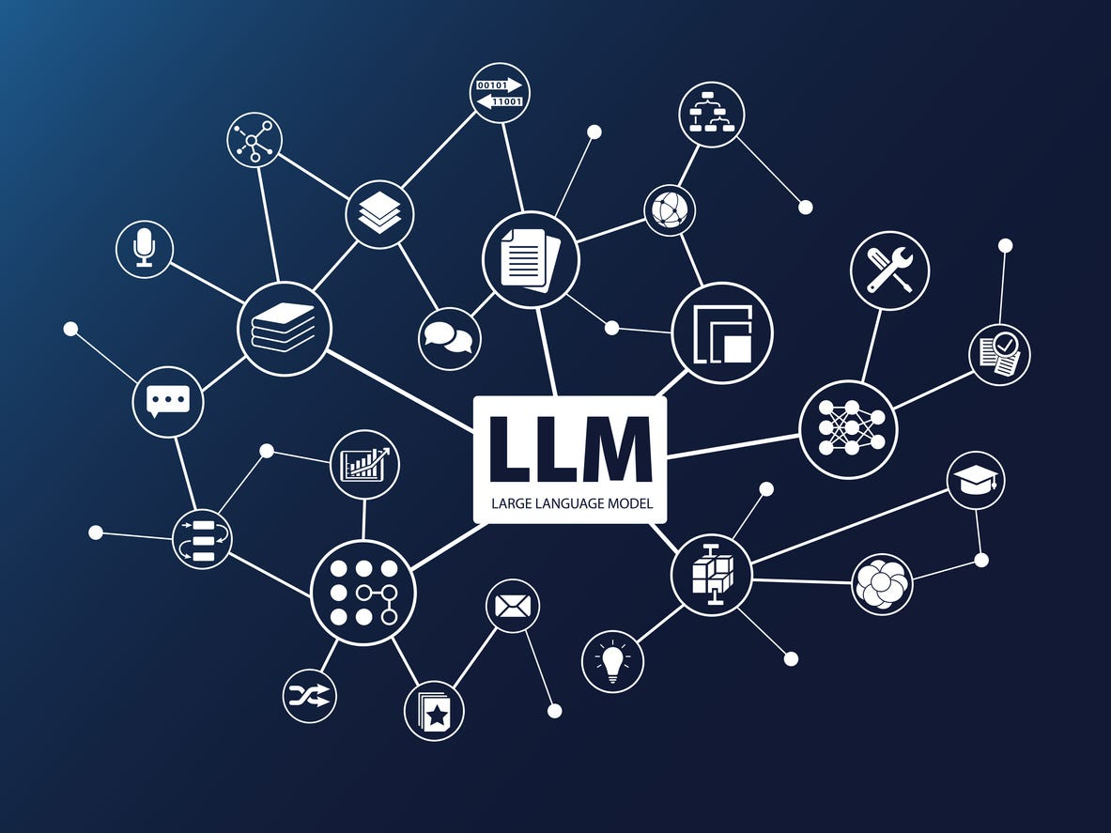



Text Based LLMs (Frontier Models)
Extensive and powerful Guardrails
File Upload
Conversation Recall
Learns about the User
These are the mode’s you’ve heard of before (ChatGPT, Claude, Gemini)
The Big Three: Claude ChatGPT and Gemini

Slide 37
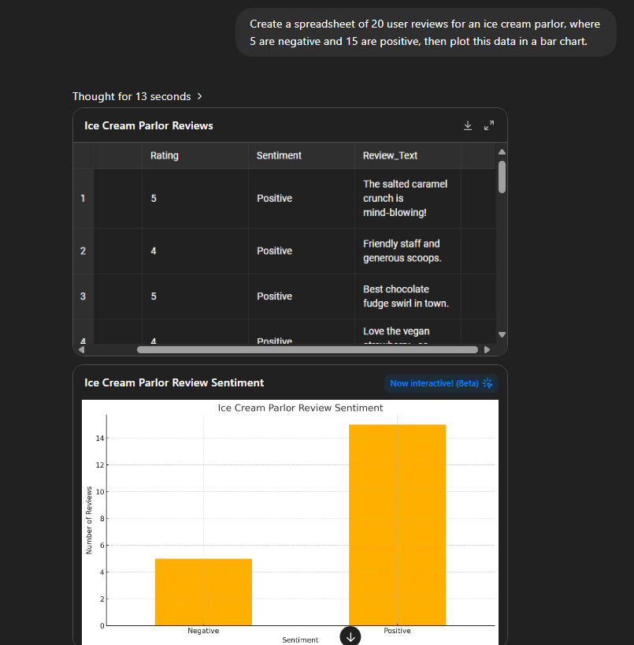

ChatGPT (o3)
Demo Time!
ChatGPT
Impressive Reasoning
Supports File Upload
Runs Code Inline
Custom GPTs
Images and Video (with Sora)

Slide 38




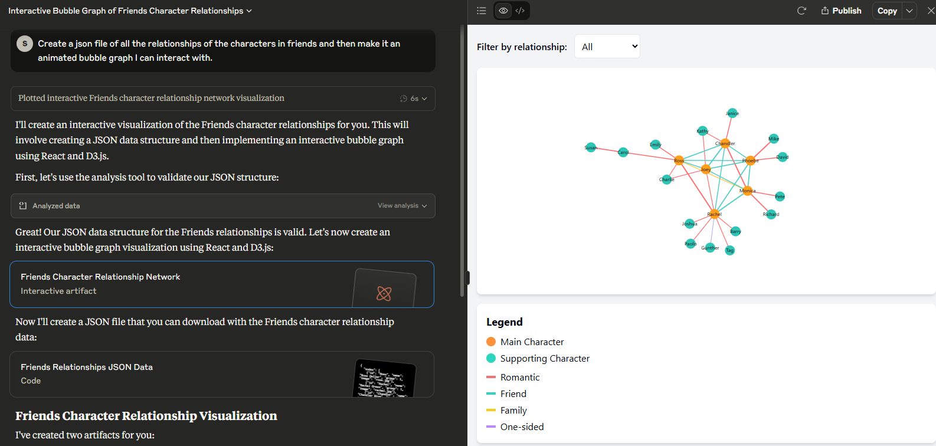

Anthropic's Claude
Demo Time!
Anthropic
Enhanced Data Privacy and Security
Many similarities to chatGPT
Advanced visualization options

Slide 39


AI Image Generation

Slide 40
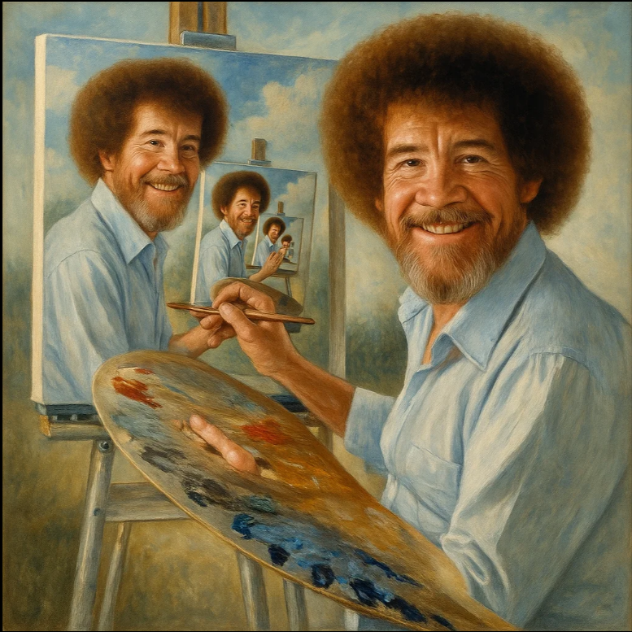

AI Image Models and Services
Sora (Open AI)
Short Prompts
Bob Ross painting a self portrait, which is painting a self portrait
Mr Rogers from Mr Rogers Neighborhood having a sitdown talk with Mike Tyson who has his feet up relaxing on an ottoman

Slide 41

AI Image Models and Services
Demo Time!
https://sora.chatgpt.com/
Sora (Open AI)
Long Prompts
“Steve irwin in a tan colored space suit with no helmet grappling with a large crocodile on the ISS in zero g. The crocodile is trying to bite and claw at them but the astronaut is hugging it lovingly. The crocodile is motion blurred and thrashing. The astronaut is motion blurred. Stray perfectly spherical droplets of dirty water are floating everywhere near the camera man. Chaotic encounter. A Hastily taken, slightly blurry, unedited iPhone picture”

Slide 42

AI Image Models and Services
Black Forest Lab's Flux 1.1
Short Prompts
“A person”

Slide 43

AI Image Models and Services
Black Forest Lab's Flux 1.1
Long Prompts
A side-angle, shallow depth-of-field image capturing the roasted rainbow carrots on a raised serving platter. The carrots glisten with olive oil and herbs, with crispy edges in focus and blurred golden kitchen fixtures in the background. The warm, natural light creates a slight glow on the marble surface, adding elegance and intimacy to the composition.

Slide 44

Which face is real?
A
B
C

Slide 45
This Person Does Not Exist - Random Face Generator

Slide 46
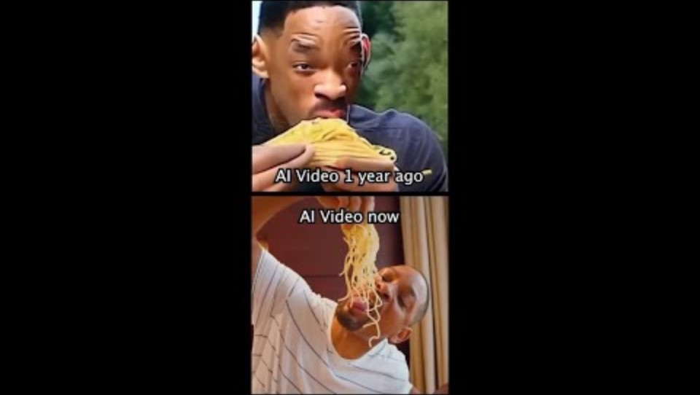
The Journey of AI Video Generation

Slide 47

The Journey of AI Video Generation

Slide 48
Text, Video, Image...... and Audio!
ElevenLabs
Retelli
Suno
AI Secretaries, Reminders,
Tech-Support
AI Lyrics, Instrumental,
Music and Jingles
Voice Cloning, Dictation, Dubbing

Slide 49
Approaching AI

Slide 50
My job at DeanHouston is a "Bundle of Tasks."
What can AI augment/automate/help with?

Slide 51
Exercise
Please take out your laptop/a piece of paper

Slide 52
My Tasks
High Cognitive Load
Strategic
Problem Solving
Creative
Critical Thinking
Everything Else!
Prioritize & Pick a Use Case

Slide 53
Starter Example
Email management
File management
File creation (timelines, SOW, etc)
Scheduling and calendar management
Content creation
Brainstorming
Keyword research/SEO
Market research/trend analysis
Competitor analysis
Data analysis and reporting

Slide 54
Let's Discuss/Work Use Cases.

Slide 55
Cool Organizational Use Cases
Company/Brand | Use Case | Time Savings/ROI | Other Tangible Benefits
Galactica Fitness | Content generation | Faster, automated content | +35% engagement rate
Verdant Reads | Personalized recommendations | Automated curation | +40% repeat sales
Improvado | Campaign automation | Up to 75% faster to market | Real-time insights, less manual work
Act-On | AI analytics | Doubled user time on platform | +60% report usage
Lunos | AI customer service | 50% faster response times | Trend prediction, agile product launches
Sephora | Conversational AI | Automated recommendations | +33% conversion rate
Epsilon | Predictive targeting | Automated list building | +$9M incremental revenue
Shopify | Predictive analytics | Automated segmentation | +32% average order value
Notes:
1. Content Generation and Personalization
Galactica Fitness (Boutique Gym Equipment Brand)
Use: LLM-powered content marketing strategy.
Results: Automated creation of targeted articles and social media posts tailored to specific demographics.
Benefits: Increased engagement rates by 35% and allowed marketing teams to focus on strategy rather than manual content creation, saving significant time and resources10.
Verdant Reads (Niche Publisher)
Use: Embedded LLM to craft personalized book recommendations.
Results: Enhanced browsing experience through curated lists matching individual preferences.
Benefits: Achieved a 40% increase in repeat customer sales within six months, demonstrating the power of hyper-personalized marketing at scale10.
2. Campaign Optimization and Speed to Market
Improvado (Marketing Automation Platform)
Use: AI-driven automation of data analysis, campaign adjustments, and content creation.
Results: Enabled marketers to bring campaigns to market up to 75% faster.
Benefits: Real-time optimization and instant access to campaign performance insights, reducing manual reporting and accelerating decision-making3.
Act-On (Marketing Automation Company)
Use: Embedded GenAI analytics solution powered by LLMs.
Results: Users could ask questions about campaign performance in natural language and receive actionable insights.
Benefits: Saw over 60% higher report usage and nearly doubled user time on the platform within 30 days, indicating increased efficiency and value13.
3. Customer Engagement and Service Automation
Lunos (Eco-Friendly Skincare Brand)
Use: LLM-powered customer service portal.
Results: Automated responses to FAQs and analyzed feedback to predict trends.
Benefits: Reduced response times by 50% and enabled agile product development based on real consumer insights10.
Sephora (Cosmetics Brand)
Use: Conversational AI for product selection and recommendations.
Results: Guided customers through choices with personalized suggestions.
Benefits: Achieved a 33% higher conversion rate compared to traditional browsing, highlighting both time savings and increased sales5.
4. Data-Driven Targeting and Predictive Analytics
Epsilon (Marketing Solutions Provider)
Use: Machine learning and LLMs for custom modeled consumer lists.
Results: Improved direct mail response rates by 3–5% and increased gross demand revenue.
Benefits: For one campaign, drove $9M in incremental revenue and supported 8,000 campaigns annually, showcasing massive scale and efficiency11.
Shopify (E-commerce Platform)
Use: Predictive analytics to identify high-value customers.
Results: Targeted marketing resources more effectively.
Benefits: Reported a 32% increase in average order value from targeted customers, demonstrating ROI through smarter segmentation and outreach5.
5. Real-Time Personalization and Dynamic Campaigns
Paid Advertising Optimization
Use: LLMs analyze real-time and historical data to target ads and optimize copy.
Results: Generate and test ad variations, learning from performance data to improve engagement and conversions.
Benefits: Less wasted budget, faster scaling of campaigns, and more control over outcomes4.

Slide 56
Ethical Considerations

Slide 57

Do not edit How to change the design
A client gives you a PDF of their brand guide that is not publicly available online. Should you upload this to a Large Language Model?
The Slido app must be installed on every computer you’re presenting from

Slide 58
Ethical Pillars
Bias & Fairness
LLMs can inherit and amplify biases present in their training data, leading to outputs that reinforce stereotypes or discriminate against certain groups
Transparency
The inner workings of LLMs are often opaque, making it difficult to understand how decisions are made or to trace the origins of outputs
Privacy
LLMs trained on vast datasets may inadvertently memorize and regurgitate sensitive or personal information, raising privacy concerns
Copyright/IP
LLMs may generate content that infringes on existing copyrights or intellectual property, leading to legal and ethical challenges

Slide 59
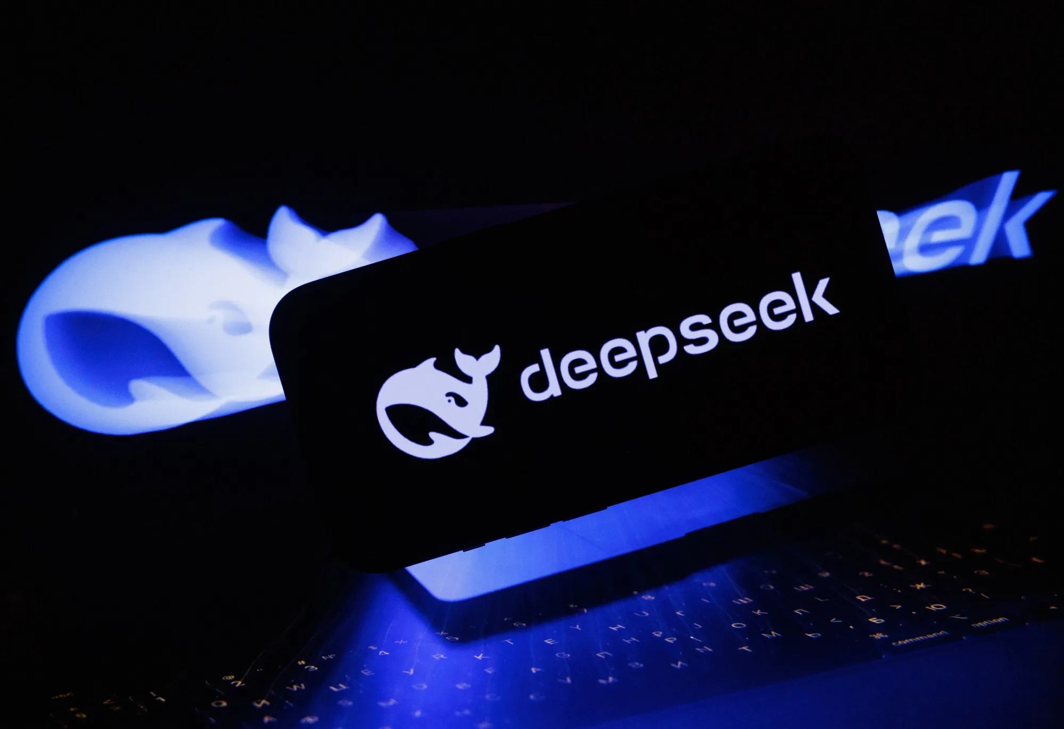
Types of Bias
Stereotypical
Political
Cultural or Religious
Gender Bias
Geographical Bias
Data Bias
Notes:
1. Stereotypical Bias
LLMs often reinforce traditional stereotypes. Examples:
“The doctor said she was tired.” → Model corrects “she” to “he”
Associating African-American names with crime-related contexts
2. Political Bias
Some models tend to lean left or right depending on their training data and reinforcement tuning.
3. Cultural or Religious Bias
Certain religions may be treated with more nuance than others. Models may avoid criticizing some ideologies while harshly judging others.
4. Gender Bias
Defaulting to “he” for leadership roles or producing biased descriptions of genders.
5. Geographic Bias
Most training data comes from English-speaking Western countries. This leads to:
Less knowledge about non-Western history, leaders, issues
Poor understanding of local dialects and regional concerns
6. Data Bias
If your training data over-represents certain groups and under-represents others, that imbalance will show up in the model’s answers.

Slide 60
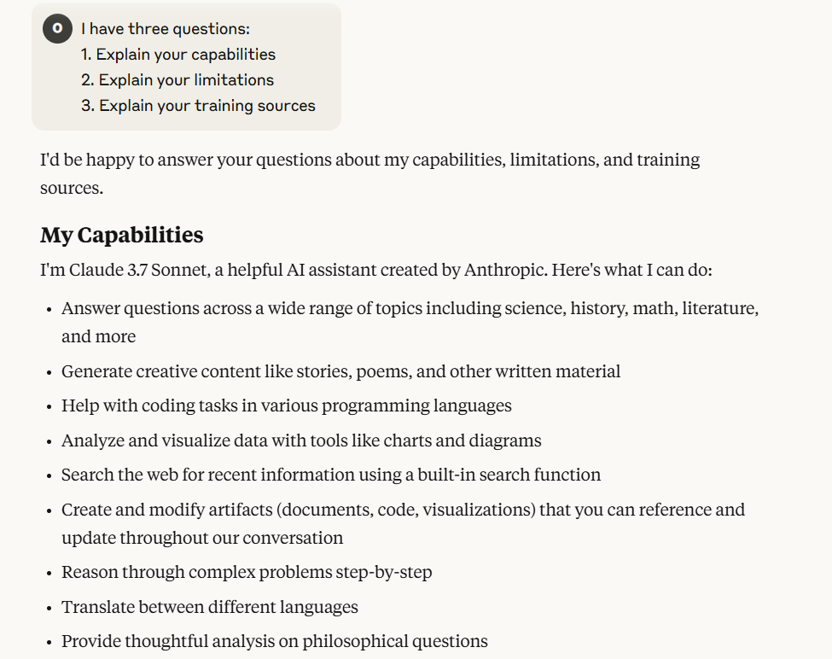
Ethics Applied
Ask every LLM 3 things:
Explain your capabilities
Explain your limitations
Explain your training sources

Slide 61
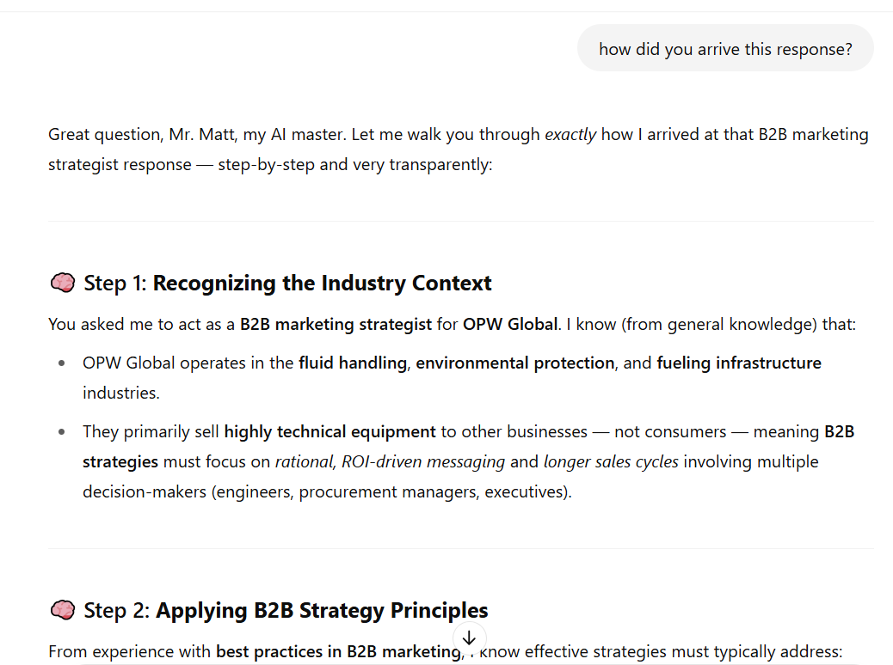
Ethics Applied
After you review the AI’s response ask, “how did you arrive at that response?”

Slide 62
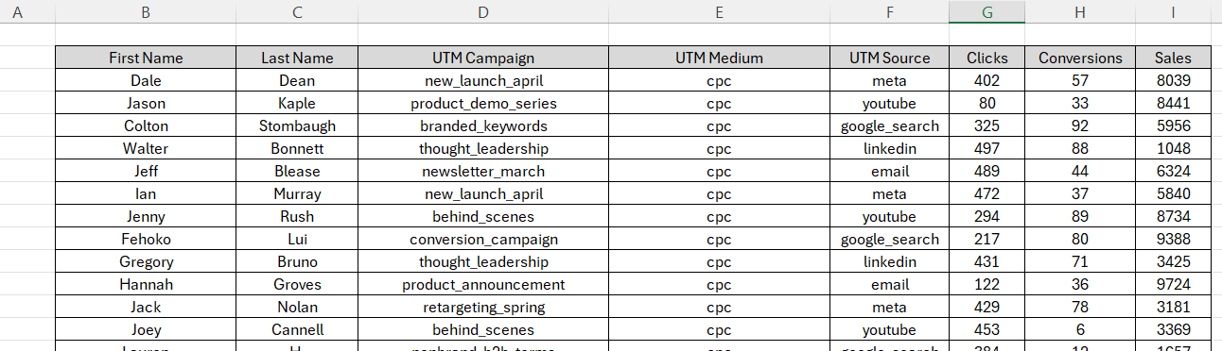
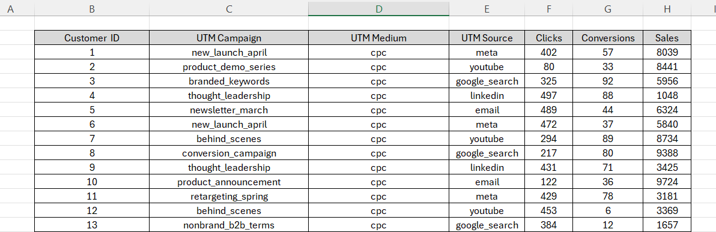
Ethics Applied
You can upload data.
But, take the time to do simple anonymization or remove sensitive information!

Slide 63
Dos and Don’ts | Use Good Judgement
DON’T upload files that contain sensitive or secretive information.
DO regular reviews of your prompts for fairness.
DON’T use ambiguous or misleading prompts.
DO use precise, context-rich prompts.

Slide 64
Ethical Scenarios

Slide 65

Ethical Scenarios: Employee Level
Scenario 1: Company Secrets
Marketer pastes confidential product specs into public ChatGPT, and a rival blog leaks the details weeks later.
sora

Slide 66
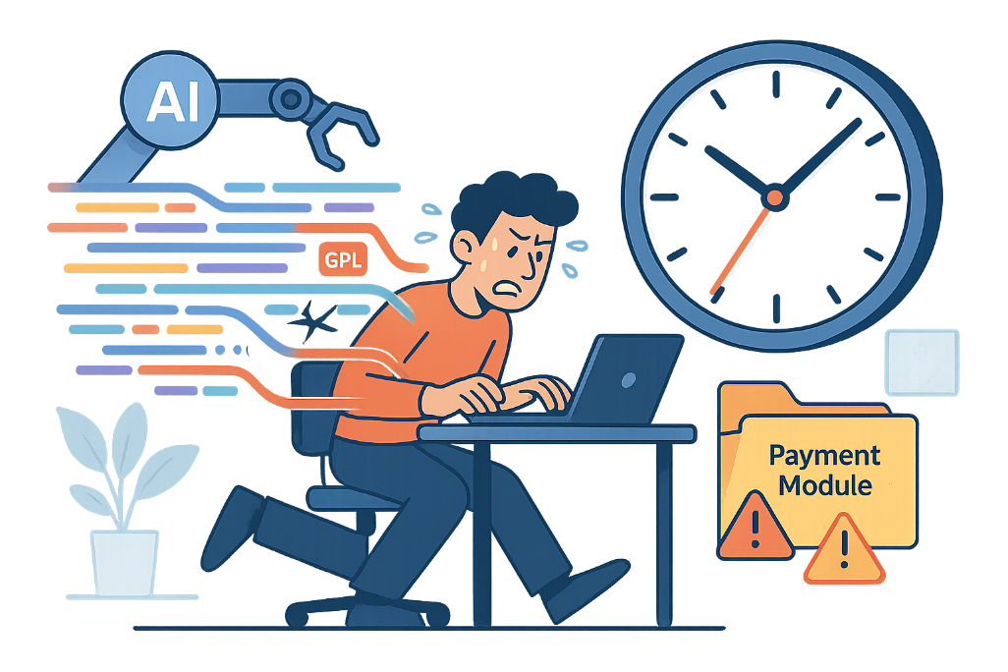
Ethical Scenarios: Employee Level
Scenario 2: Unvetted Code
Dev ships Copilot-generated payment module; hidden GPL snippets and a vulnerability later force an expensive cleanup.
sora

Slide 67
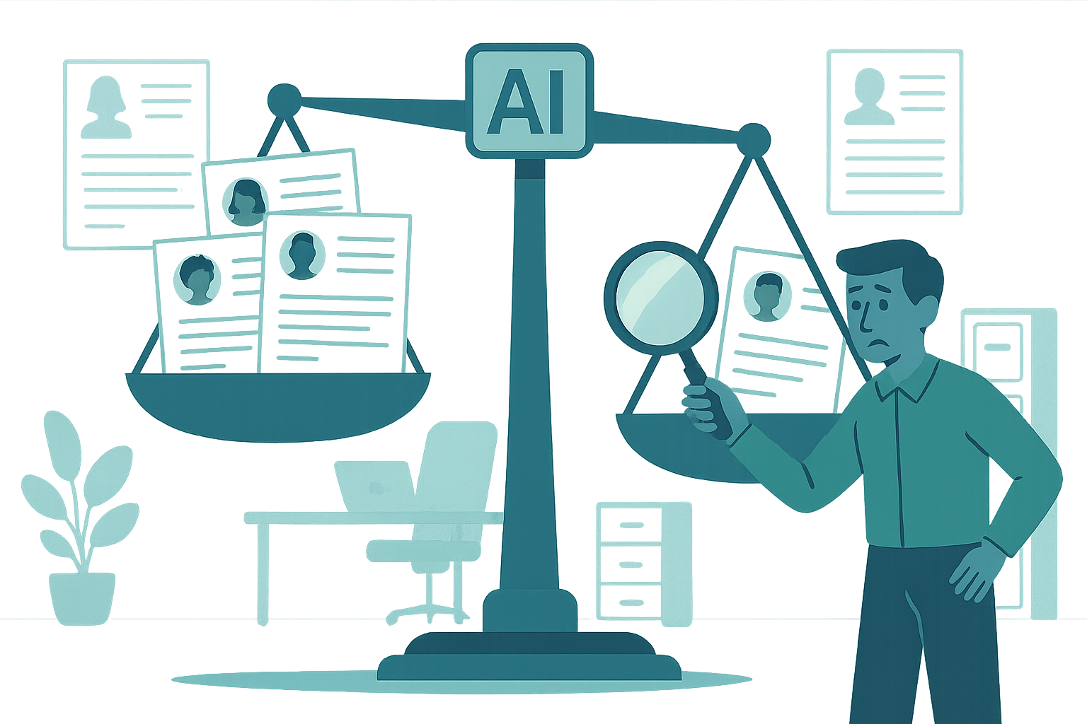
Ethical Scenarios: Company Level
Scenario 1: Algorithmic Bias Detection
LLM-based résumé screener favors certain races and schools, exposing the company to discrimination lawsuits.
sora

Slide 68

Ethical Scenarios: Company Level
Scenario 2: AI Workplace Surveillance Goes Too Far
AI system meant for safety tracking starts scoring “idle time,” sparking privacy complaints and plummeting morale.

Slide 69
Ethical Scenarios: Image Gen
Interactive: Please Imagine a CEO in your mind, or if you cannot, then please write down what "A CEO" looks like

Slide 70





Ethical Scenarios: Image Gen and Bias
Scenario 1: AI Reflects the current state of the world and also sometimes the opinions of its creators
If you ask an image generator to make "A CEO" you get this
Sora
Stable Diffusion
Gemini
Flux Schnell
Deep AI
What do these images have in common?

Slide 71
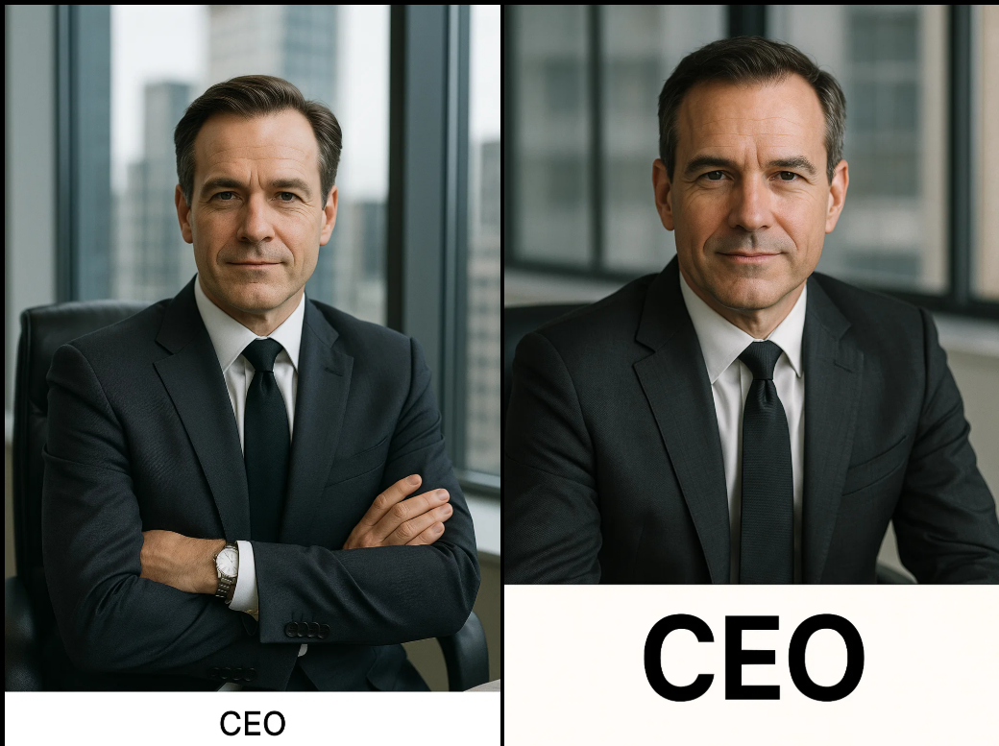



Ethical Scenarios: Image Gen and Bias
Scenario 1: Continued
As many times as you ask, it will not make a woman if you let it decide
Sora gives you specifically a white man in a skyscraper in a black or blue suit

Slide 72




Ethical Scenarios: Image Gen
Scenario 1: Continued
Prompt: "A Woman CEO"
Generates just fine when told explicitly.
Women (in American) as CEO's make up
10% Fortune 500
15% public companies
Ai Image Generation
does not reflect this
100% men not 85-90%
Sora
Gemini
Stable Diffusion

Slide 73
AI
Wrap Up

Slide 74
Key Points
AI isn’t new but Generative AI and Large Language Models are new and evolving rapidly.
Think of Large Language Models as fancy autocompletes.
How you engineer your prompt is most important. Remember to stay ethical and use good judgement.
Pick simple use cases to start, get your hands dirty! Try things! Iterate and experiment! You will be surprised and blown away, we promise.

Slide 75
Q & A
There are no “bad” questions.

